Slide 1



Retail Price Optimization Project
Round 1 – G5e
Group G3
By : Ahmed Mohamed Shaaban Ali
By : Mahmoud Abdel Hamid Abdel Hamid
By : Abdel Rahman Mohamed Saad
Muhammad
Eng : Marwan Mahmoud Mukhtar

Slide 2

Agenda
Retail Price Optimization overview
Retail Price Optimization Home page
Retail Price Optimization Product page
Retail Price Optimization Price page
Retail Price Optimization Competitors page
Retail Price Optimization Recommendation page
Retail Price Optimization Top Questions page

Slide 3
Retail Price Optimization overview
Retail price optimization involves determining the best pricing strategy to maximize revenue and profits while considering various factors such as customer demand, competition, and market conditions.
The objectives of retail price optimization can include:
Maximizing Revenue
Increasing Profit Margins
Competitive Positioning
Demand Forecasting
Customer Segmentation
Inventory Management

Slide 4
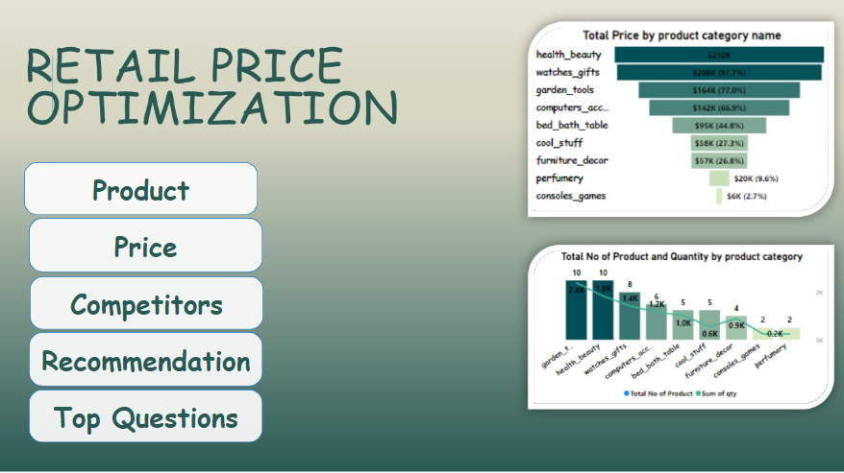
Retail Price Optimization Home page
About The Retail Price Optimization Home page
Consists Of Several Buttons To Go Directly To The Desired Page

Slide 5
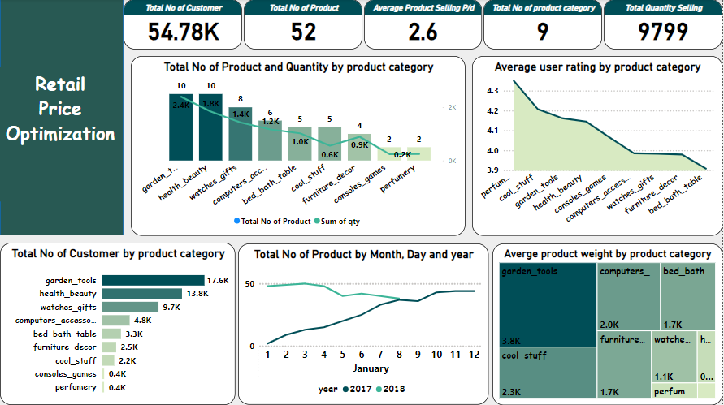
Retail Price Optimization
Product page
About The Product page we have five card In the top of the page that shows:
Total No of customer
Total No of Product
Average Product Selling P/d
Total No of product category
Total Quantity Selling
Line and Clustered Column Chart: This explains the total no of product and quantity by product category
Area Chart: This explains the average user rating by product category
Stacked bar chart: This explains the total No of Customer by product
Line Chart: This explains the total No of Product by Month, Day and year
Tree Map chart: This explains the Average product weight by product category

Slide 6
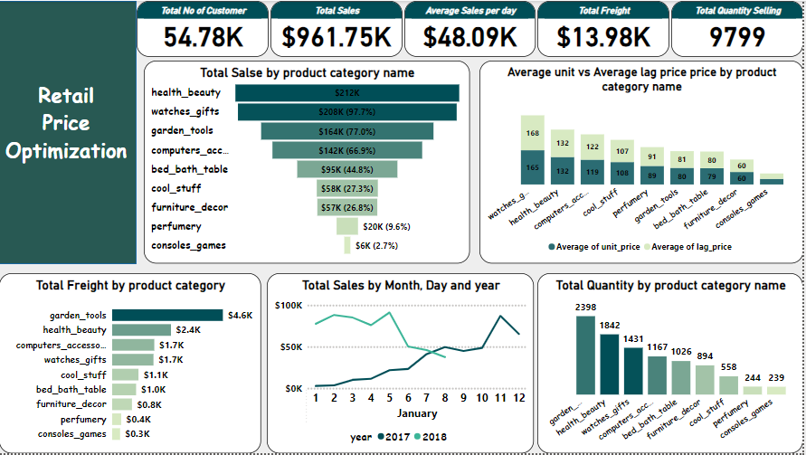
Retail Price Optimization
Price page
About The Price page we have five card In the top of the page that shows:
Total No of customer
Total Sales
Average Sales per day
Total Freight
Total Quantity Selling
Funnel Chart: This explains the Total Sales by product category name
Stacked Colum Chart: This explains the average unit vs Average lag price by product category name
Stacked bar chart: This explains the Total Freight by product category
Line Chart: This explains the Total Sales by Month, Day and year
Stacked Colum Chart : This explains Total Quantity by product category name

Slide 7
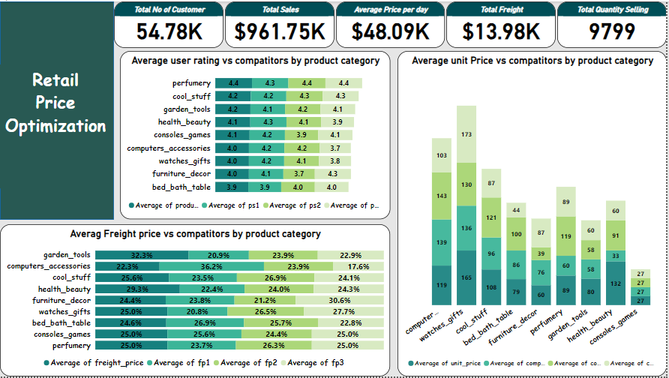
Retail Price Optimization
Competitors page
About The Competitors page we have five card In the top of the page that shows:
Total No of customer
Total Sales
Average Sales per day
Total Freight
Total Quantity Selling
Stacked bar chart: This explains the Average user rating vs competitors by product category
Stacked Colum Chart: This explains the Average unit Price vs competitors by product category
Stacked bar chart: This explains the Average Freight price vs competitors by product category

Slide 8
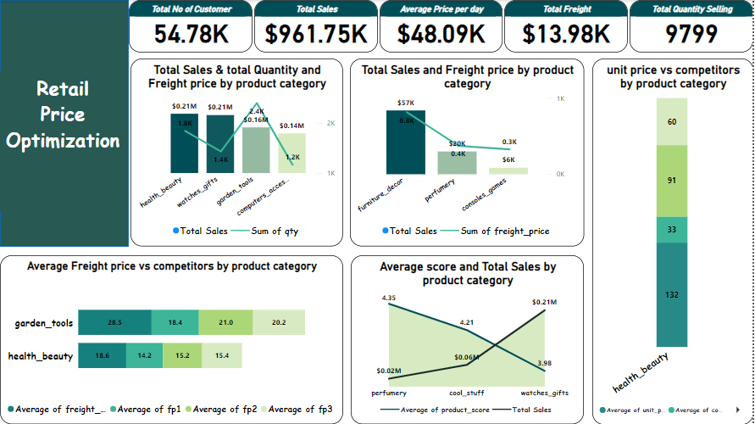
Retail Price Optimization
Recommendation page
About The Recommendation page we have five card In the top of the page that shows:
Total No of customer
Total Sales
Average Sales per day
Total Freight
Total Quantity Selling
Line and Stacked Colum Chart: This explains the Total Sales & total Quantity and Freight price by product category
Line and Stacked Colum Chart: This explains the Total Sales and Freight price by product category
Stacked bar chart: This explains the Average Freight price vs competitors by garden-tools and health-beauty product category
Area chart: This explains the Average score and Total Sales by product category
Stacked Colum Chart: This explains the unit price vs competitors by health-beauty product category
.

Slide 9
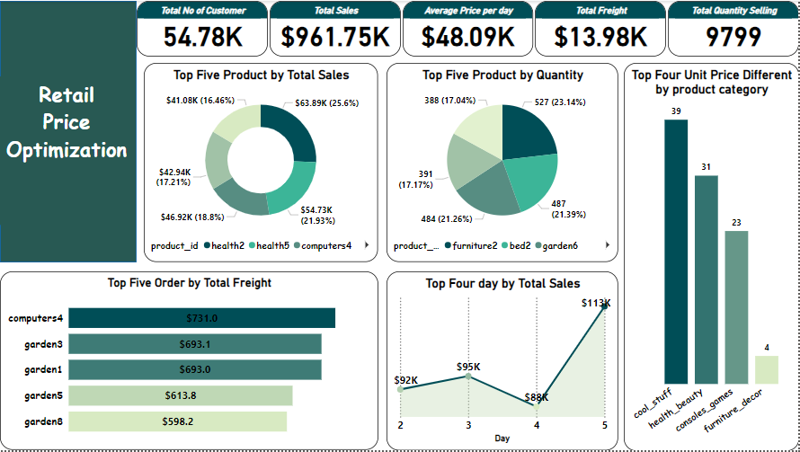
Retail Price Optimization
Top Questions page
About The Top Questions page we have five card In the top of the page that shows:
Total No of customer
Total Sales
Average Sales per day
Total Freight
Total Quantity Selling
Donut Chart: This explains the top five Product by total sales
Pie Chart: This explains the top five product by quantity
Stacked bar chart: This explains the top five order by total freight
Line chart: This explains the top four day by total sales
Stacked Colum Chart: This explains the top four Unit price different by product category

Slide 10
Thank You

